Slide 1





Error Handling and Advance Java
Disclaimer: The content is curated for educational purposes only.
Notes:
Introduce the topic - Error Handling and Advance Java

Slide 2

Learning Objectives
Java Exception
Types of Java Exception
Exception Handling
Try and Catch the block
Threading
Collection
Lambda
Annotation
Notes:
Java Exception
Types of Java Exception
Exception Handling
Try and Catch the block
Threading
Collection
Lambda
Annotation

Slide 3
Introduction
Welcome everyone to the presentation on Error Handling and Advanced Java Concepts.
Error handling, also known as exception handling, is a crucial aspect of software development that involves dealing with and managing errors, exceptions, and abnormal conditions that may occur during the execution of a program.
It is essential for creating robust and reliable software systems.
Throwable
Error
Exception
Runtime Exception
IOException
Notes:
Discuss what is error and error handling. Also discuss the difference between error and exception.
-----------------------------------------------------------------
Introduction
Welcome everyone to the presentation on Error Handling and Advanced Java Concepts.
Error handling, also known as exception handling, is a crucial aspect of software development that involves dealing with and managing errors, exceptions, and abnormal conditions that may occur during the execution of a program.
It is essential for creating robust and reliable software systems.

Slide 4
Java Exceptions
An exception is an unexpected event that occurs during program execution.
An exception is an event that disrupts the normal flow of the program
Throwable
Error
Exception
Runtime Exception
IOException
Java Exception Hierarchy
Click here
Reference link
Notes:
Java Exceptions
An exception is an unexpected event that occurs during program execution. It affects the flow of the program instructions which can cause the program to terminate abnormally.
An exception can occur for many reasons. Some of them are:
Invalid user input
Device failure
Loss of network connection
Physical limitations (out of disk memory)
Code errors
Opening an unavailable file

Slide 5
Types of Java Exceptions
Errors
Errors represent irrecoverable conditions
Errors are usually beyond the control of the programmer, and we should not try to handle errors.
Exceptions
Exceptions can be caught and handled by the program.
Throwable
Error
Exception
Runtime Exception
IOException
Java Exception Hierarchy
Click here
Reference link
Notes:
Types of Java Exceptions
Here is a simplified diagram of the exception hierarchy in Java. The Throwable class is the root class in the hierarchy.
The hierarchy splits into two branches: Error and Exception.
Errors
Errors represent irrecoverable conditions such as Java virtual machine (JVM) running out of memory, memory leaks, stack overflow errors, library incompatibility, infinite recursion, etc.
Errors are usually beyond the control of the programmer and we should not try to handle errors.
Exceptions
Exceptions can be caught and handled by the program.
When an exception occurs within a method, it creates an object. This object is called the exception object.
It contains information about the exception such as the name and description of the exception and state of the program when the exception occurred.
Reference - https://www.programiz.com/java-programming

Slide 6
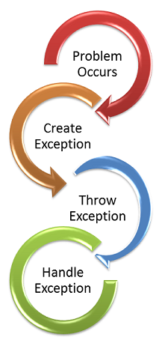
Exception Handling
Exception handling is a programming technique that allows for the detection, handling, and recovery of exceptional conditions or errors that may occur during the execution of a program.
It involves using try-catch blocks to catch and handle exceptions, ensuring the program continues to run smoothly and preventing unexpected crashes.
Click here
Reference link
Notes:
Exception Handling
Exception handling is a programming technique that allows for the detection, handling, and recovery from exceptional conditions or errors that may occur during the execution of a program. It involves using try-catch blocks to catch and handle exceptions, ensuring the program continues to run smoothly and preventing unexpected crashes.

Slide 7
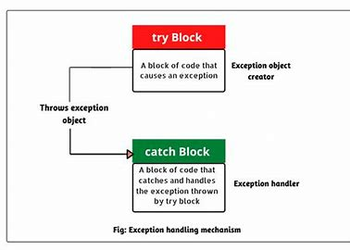
Java try...catch
The try...catch block in Java is used to handle exceptions and prevent the abnormal termination of the program.
The try block includes the code that might generate an exception.
The catch block includes the code that is executed when there occurs an exception inside the try block.
In Java, we can use a try block without a catch block. However, we cannot use a catch block without a try block.
Click here
Reference link
Notes:
Java try...catch
The try...catch block in Java is used to handle exceptions and prevents the abnormal termination of the program.
The try block includes the code that might generate an exception.
The catch block includes the code that is executed when there occurs an exception inside the try block.
In Java, we can use a try block without a catch block. However, we cannot use a catch block without a try block.
Reference - https://www.programiz.com/java-programming

Slide 8
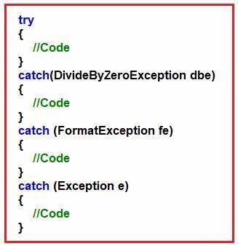
Multiple Catch Blocks
For each try block, there can be zero or more catch blocks.
Multiple catch blocks allow us to handle each exception differently.
The argument type of each catch block indicates the type of exception that can be handled by it.
Notes:
Multiple Catch blocks
For each try block, there can be zero or more catch blocks.
Multiple catch blocks allow us to handle each exception differently.
The argument type of each catch block indicates the type of exception that can be handled by it.
Reference - https://www.programiz.com/java-programming

Slide 9
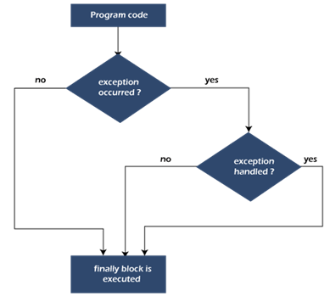
Finally Block
The finally block is always executed whether there is an exception inside the try block or not.
The code inside the finally block is executed irrespective of the exception.
It is a good practice to use finally block to include important cleanup code like closing a file or connection.
Notes:
Finally Block
The finally block is always executed whether there is an exception inside the try block or not.
The code inside the finally block is executed irrespective of the exception.
It is a good practice to use finally block to include important cleanup code like closing a file or connection.
Reference - https://www.programiz.com/java-programming

Slide 10
Java Throw and Throws
Java throws keyword
The throws keyword in the method declaration to declare the type of exceptions that might occur within it.
Java throw keyword
The throw keyword is used to explicitly throw a single exception.
Notes:
In Java, exceptions can be categorized into two types:
Unchecked Exceptions: They are not checked at compile-time but at run-time.For example: ArithmeticException, NullPointerException, ArrayIndexOutOfBoundsException, exceptions under Error class, etc.
Checked Exceptions: They are checked at compile-time. For example, IOException, InterruptedException, etc.
Usually, we don't need to handle unchecked exceptions.
It's because unchecked exceptions occur due to programming errors. And, it is a good practice to correct them instead of handling them.
Java throws keyword
We use the throws keyword in the method declaration to declare the type of exceptions that might occur within it.
If a method does not handle exceptions, the type of exceptions that may occur within it must be specified in the throws clause so that methods further up in the call stack can handle them or specify them using throws keyword themselves.
Java throw keyword
The throw keyword is used to explicitly throw a single exception.
When an exception is thrown, the flow of program execution transfers from the try block to the catch block.
We use the throw keyword within a method.
A throwable object is an instance of class Throwable or subclass of the Throwable class.
Reference - https://www.programiz.com/java-programming

Slide 11
Lab Exercise:
HandsOn – 87: Example of error handling in java
HandsOn – 88: Example of exception handling in java
Notes:
Trainer will switch to VS code and execute the example to understand Error handling and exception handling in detail

Slide 12
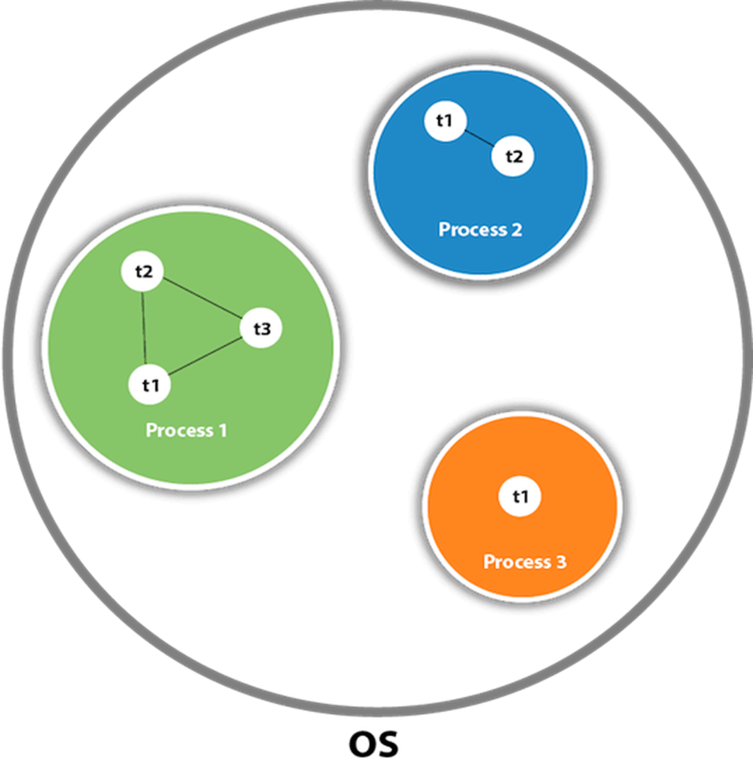
Threading
A thread is a lightweight subprocess, the smallest unit of processing. It is a separate path of execution.
process of executing multiple threads simultaneously is called Multithreading in Java.
There are two ways to create a thread:
1) By extending the Thread class
2) By implementing a Runnable interface.
Click here
Reference link
Notes:
Try to understand what is the concept of threading in students’ mind. Discuss threding and working of it in detail. Give some examples to make it more clear.
--------------------------------------------------------------------------
Threading
A thread is a lightweight subprocess, the smallest unit of processing. It is a separate path of execution.
process of executing multiple threads simultaneously is called Multithreading in Java.
There are two ways to create a thread:
1) By extending the Thread class
2) By implementing a Runnable interface.

Slide 13
Lab Exercise:
HandsOn – 89: Example of threading
Notes:
Trainer will switch to VS code and execute the example to understand threading in detail

Slide 14
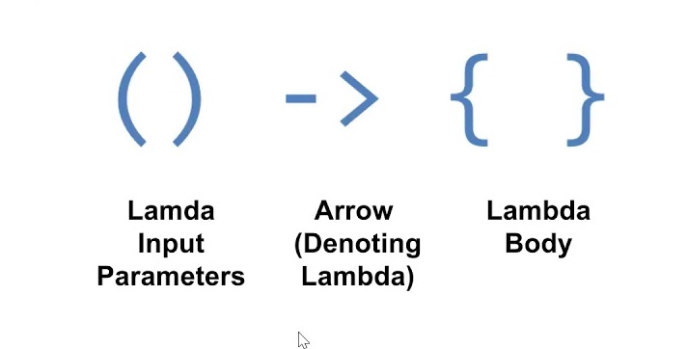
Java Lambda Expressions
The Lambda expression is used to provide the implementation of an interface that has a functional interface.
It saves a lot of code. In the case of the lambda expression, we don't need to define the method again for providing the implementation.
Why use Lambda Expression
1. To provide the implementation of the Functional interface.
2. Less coding.
Notes:
Explain the concept in detail with example
-----------------------------------------------------
Java Lambda Expressions
The Lambda expression is used to provide the implementation of an interface that has a functional interface.
It saves a lot of code. In the case of the lambda expression, we don't need to define the method again for providing the implementation.
Why use Lambda Expression
1. To provide the implementation of the Functional interface.
2. Less coding.

Slide 15
Java Lambda Expressions
No Parameter Syntax
() -> {
//Body of no parameter lambda }
One Parameter Syntax
(p1) -> {
//Body of single parameter lambda
}
Two Parameter Syntax
(p1,p2) -> {
//Body of multiple parameter lambda
}
Notes:
Java Lambda Expressions
Java lambda expression has consisted of three components.
1) Argument list: It can be empty or non-empty as well.
2) Arrow-token: It is used to link the arguments list and body of expression.
3) Body: It contains expressions and statements for lambda expression.

Slide 16
Lab Exercise:
HandsOn – 90: Example of Lambda
Notes:
Trainer will switch to VS code and execute the example to understand Lambda in detail

Slide 17
Collections in Java
The Collection in Java is a framework that provides an architecture to store and manipulate a group of objects.
Collections in Java provide a framework for efficient storage, retrieval, and manipulation of groups of objects.
The Collection Framework in Java includes interfaces, implementations, and algorithms for working with collections.
Notes:
Explain the concept with example
--------------------------------------------------------------
Collections in Java
The Collection in Java is a framework that provides an architecture to store and manipulate a group of objects.
Collections in Java provide a framework for efficient storage, retrieval, and manipulation of groups of objects.
The Collection Framework in Java includes interfaces, implementations, and algorithms for working with collections.

Slide 18
Collection Framework
The Collection Framework in Java is a unified architecture that provides a set of interfaces, classes, and algorithms to work with collections of objects.
It offers a standardized way to store, manipulate, and process groups of objects efficiently.
The Collection Framework is part of the java.util package and serves as a foundation for working with collections in Java.
Notes:
Collection Framework
The Collection Framework in Java is a unified architecture that provides a set of interfaces, classes, and algorithms to work with collections of objects.
It offers a standardized way to store, manipulate, and process groups of objects efficiently.
The Collection Framework is part of the java.util package and serves as a foundation for working with collections in Java.

Slide 19
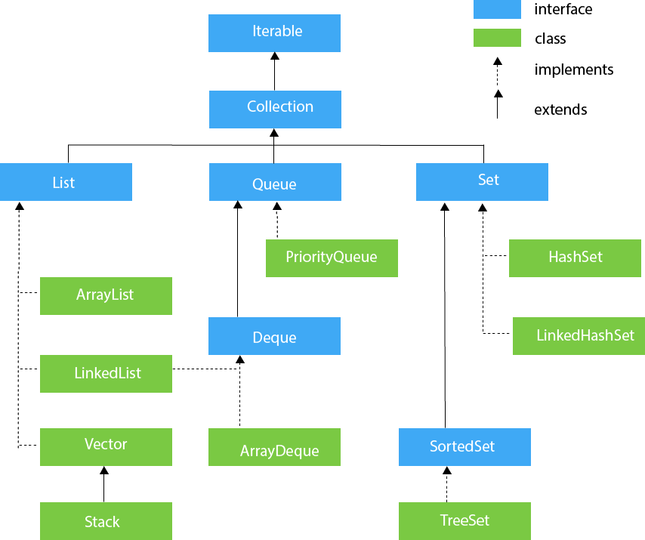
Hierarchy of Collection Framework
Notes:
Hierarchy of Collection Framework
Let us see the hierarchy of Collection framework. The java.util package contains all the classes and interfaces for the Collection framework.
The Collection Framework in Java provides a unified architecture for representing and manipulating groups of objects. It consists of several interfaces and classes that organize different types of collections and provide various operations for working with them. The hierarchy of the Collection Framework is as follows:
Collection Interface:
The root interface of the collection hierarchy.
Represents a group of objects.
Provides basic operations for adding, removing, and accessing elements.
1. List Interface (extends Collection):
Represents an ordered collection (sequence) of elements.
Allows duplicate elements.
Provides methods for positional access, searching, and manipulation.
1.1 ArrayList (implements List):
Resizable array-based implementation of the List interface.
Provides fast element access and dynamic resizing.
1.2 LinkedList (implements List):
Doubly-linked list implementation of the List interface.
Provides efficient insertion and deletion at both ends of the list.
1.3Vector (implements List):
Synchronized resizable array-based implementation of the List interface.
Similar to ArrayList but with synchronized methods.
2. Queue Interface (extends Collection):
Represents a collection designed for holding elements prior to processing.
Follows the First-In-First-Out (FIFO) order.
LinkedList (implements Queue):
Doubly-linked list implementation that also implements the Queue interface.
Supports efficient insertion and deletion at both ends.
PriorityQueue (implements Queue):
Priority heap-based implementation of the Queue interface.
Elements are ordered based on their natural ordering or a specified comparator.
3.Set Interface (extends Collection):
Represents a collection of unique elements (no duplicates).
Provides methods for set operations such as union, intersection, and difference.
3.1 HashSet (implements Set):
Hash table-based implementation of the Set interface.
Offers constant-time performance for the basic operations.
3.2LinkedHashSet (implements Set):
Hash table and linked list-based implementation of the Set interface.
Maintains insertion order of elements.
3.3 TreeSet (implements Set):
Red-Black tree-based implementation of the Set interface.
Maintains elements in sorted order.

Slide 20
Java Annotations
Annotations are used to provide supplemental information about a program.
Annotations start with ‘@’.
Annotations do not change the action of a compiled program.
Annotations help to associate metadata (information) to the program elements
Notes:
Explain the concept as well as provide the examples where to use annotations
--------------------------------------------------
Annotations are used to provide supplemental information about a program.
Annotations start with ‘@’.
Annotations do not change the action of a compiled program.
Annotations help to associate metadata (information) to the program elements
There are several built-in annotations in Java. Some annotations are applied to Java code and some to other annotations.
Built-In Java Annotations used in Java code
@Override
@SuppressWarnings
@Deprecated
Built-In Java Annotations used in other annotations
@Target
@Retention
@Inherited
@Documented

Slide 21
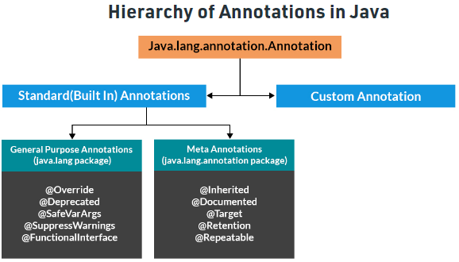
Java Annotations
Standard (Built In) Annotations
Custom Annotation
Click here
Reference link
Notes:
Look at the slide. You can observe that there are 2 types of annotations:
1. Standard and
2. Custom
Further standard annotations could be categorized into General purpose and Meta annotations.

Slide 22
Lab Exercise:
HandsOn – 91: Example of Annotations
Notes:
Trainer will switch to VS code and execute the example to understand concepts in detail

Slide 23

Summary
Well done! You have completed this course and now you have understand about:
Java Exception
Types of Java Exception
Exception Handling
Try and Catch the block
Threading
Collection
Lambda
Annotation
Notes:
Summary
Well done! You have completed this course and now you have understand about:
Java Exception
Types of Java Exception
Exception Handling
Try and Catch the block
Threading
Collection
Lambda
Annotation
23

Slide 24
Quiz
1. Predicting the amount of rainfall in a region based on various cues is a ______ problem.​
Try
finally
thrown
catch
Answer: c) thrown
Notes:
1. Predicting the amount of rainfall in a region based on various cues is a ______ problem.​
a) Try b) finally
c) thrown
d) catch
Answer: c Explanation: Exceptional handling is managed via 5 keywords – try, catch, throws, throw and finally.
24

Slide 25
Quiz
2. What will be the output of the Java program?
a) Hello
b) World
c) HelloWorld
d) Hello World
Answer: b) World
class exception_handling
{
public static void main(String args[])
{
try
{
System.out.print("Hello" + " " + 1 / 0);
}
catch(ArithmeticException e)
{
System.out.print("World");
}
}
}
Notes:
2. What will be the output of the Java program?
a) Hello
b) World
c) HelloWorld
d) Hello World
Answer: b Explanation: System.ou.print() function first converts the whole parameters into a string and then prints, before “Hello” goes to output stream 1 / 0 error is encountered which is cached by catch block printing just “World”.
25

Slide 26
Quiz
3. Which version of Java introduced annotation?
a) Java 5
b) Java 6
c) Java 7
d) Java 8
Answer: a) Java 5
Notes:
3. Which version of Java introduced annotation?
a) Java 5
b) Java 6
c) Java 7
d) Java 8
Answer: a Explanation: Annotation were introduced with Java 5 version.
26

Slide 27
Quiz
4. Which of these methods deletes all the elements from invoking collection?
a) clear()
b) reset()
c) delete()
d) refresh()
Answer: a) clear()
Notes:
4. Which of these methods deletes all the elements from invoking collection?
a) clear()
b) reset()
c) delete()
d) refresh()
Answer: a Explanation: clear() method removes all the elements from invoking collection.
27

Slide 28
Quiz
5. What is the use of try & catch?
a) It allows us to manually handle the exception
b) It allows to fix errors
c) It prevents automatic terminating of the program in cases when an exception occurs
d) All of the mentioned
Answer: d) All of the mentioned
Notes:
5. What is the use of try & catch?
a) It allows us to manually handle the exception
b) It allows to fix errors
c) It prevents automatic terminating of the program in cases when an exception occurs
d) All of the mentioned
Ans: D) All of the mentioned
28

Slide 29
Reference
https://www.geeksforgeeks.org/errors-v-s-exceptions-in-java/
https://www.javatpoint.com/exception-vs-error-in-java
https://www.javatpoint.com/multithreading-in-java
https://www.baeldung.com/java-errors-vs-exceptions
https://www.youtube.com/watch?v=y-NlcLcxiKY&list=PLlhM4lkb2sEjaU-JAASDG4Tdwpf-JFARN
https://www.youtube.com/watch?v=1xuDEPftKV0&t=191s
Notes:
References
29

Slide 30
Thank you!
Notes:
Thank You
30

